Slide 1
Medical Appointments showing up Prediction
- Ziyan Saleem

Slide 2
Introduction
People not showing up for their medical appointments is effecting the smooth running of health industry.
Taking appointment and not showing up for it results in wasting of both time and money.
This study compare the accuracy of various machine learning algorithms in predicting people showing up for medical appointments.
These algorithms include Logistic Regression , Decision Trees , Random Forest , KNN , Naïve Bayes , Ensemble Models
Predicting will be challenging as the accuracy of the prediction completely depends on the dataset so we need to be focused on data wrangling , EDA , Feature engineering and all

Slide 3
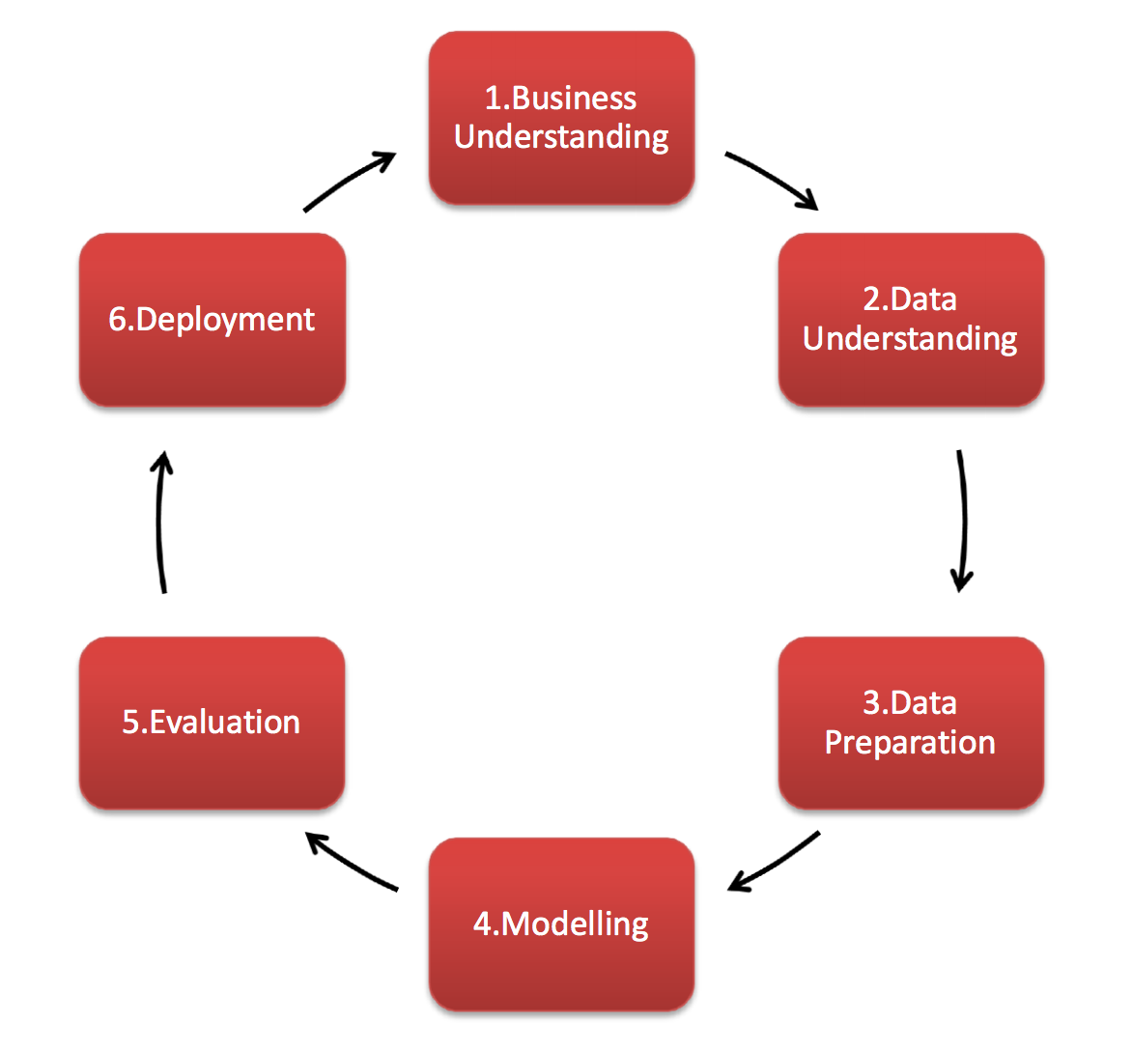
Methodology
CRISP DM Approach

Slide 4
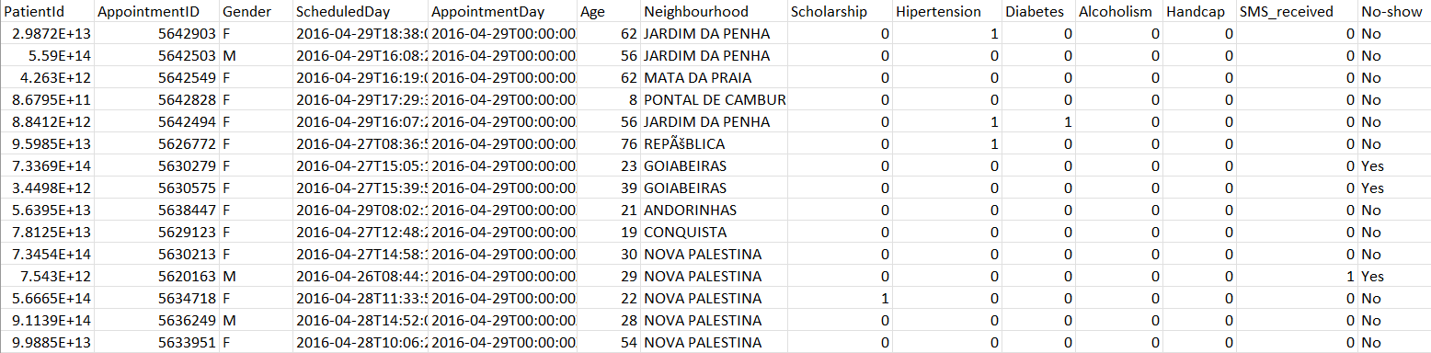
Table contents

Slide 5
Steps followed
Performed EDA and Data visualization
Treated Outliers.
Did bi-variate analysis according to the features in data.
Derived new columns from the existing one , which would help creating the models.
Converted Categorical features to continuous using LabelEncoder
Standardized the data using standard scaler
Used SMOTE to oversample the data to balance it.
Different machine learning algorithms and hyperparameter tunings were implemented.
At each stage, a very in depth analysis were made while choosing the algorithms and parameters.
Compared the accuracy of each model.

Slide 6
Data Visualization

Slide 7
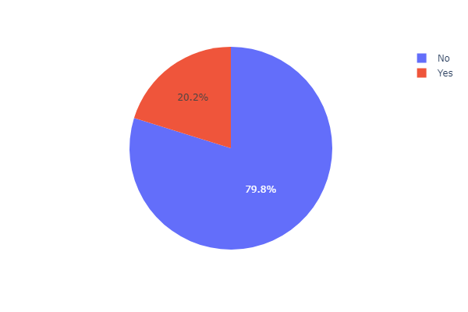
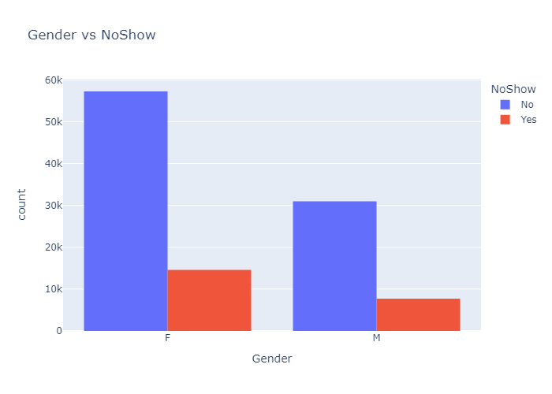
Data distribution across Y-VARIABLE
HISTOGRAM ON GENDER VS NO-SHOW

Slide 8
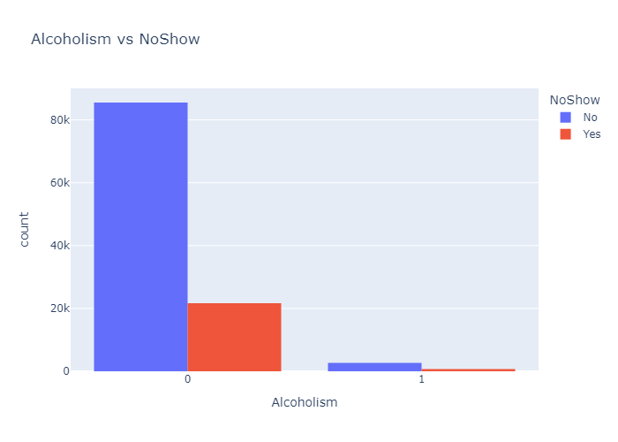
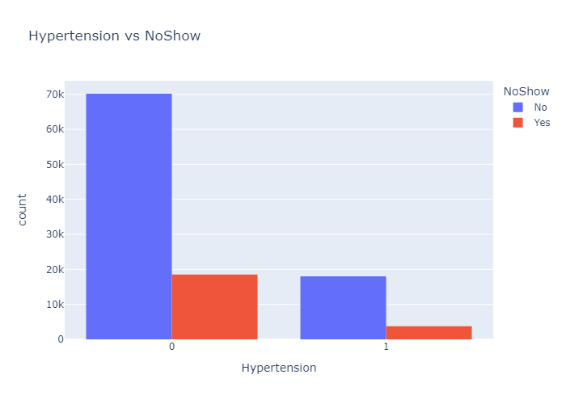
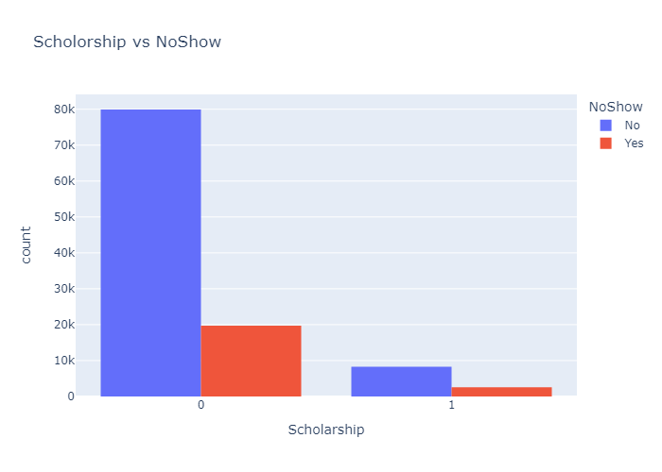
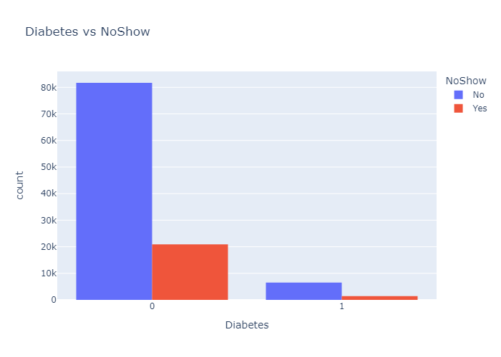
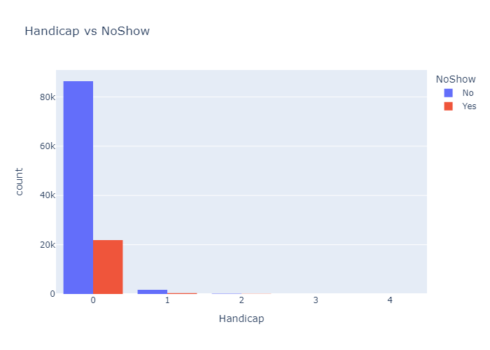
FEW MORE CHARTS FOR BETTER DATA UNDERSTANDING

Slide 9
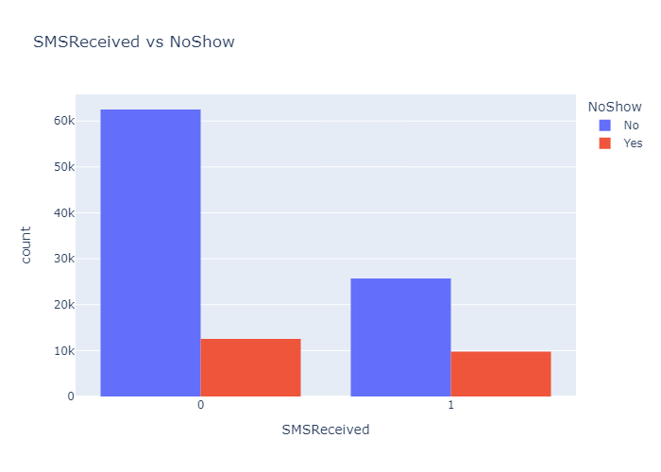
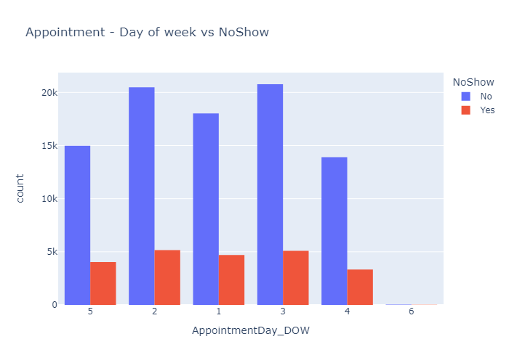
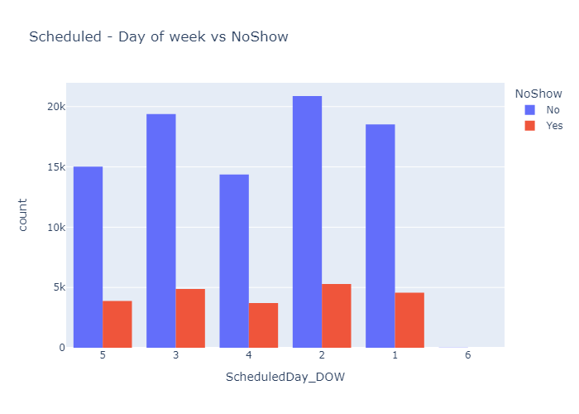
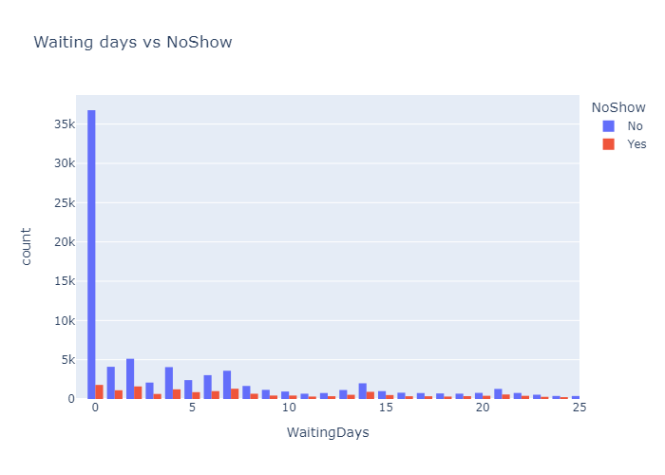

Slide 10
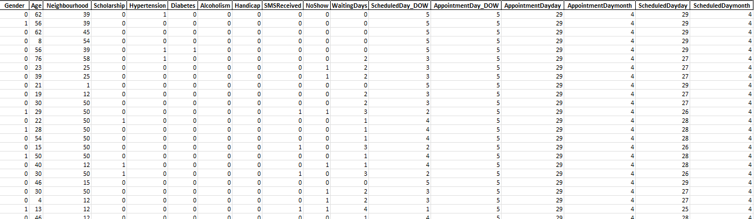
Table contents AFTER EDA AND FEATURE ENGINEERING

Slide 11
Algorithms implemented

Slide 12





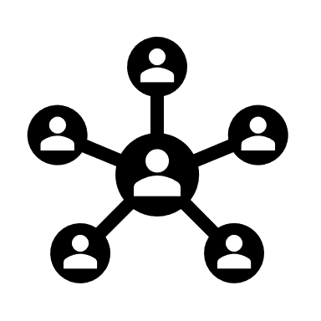
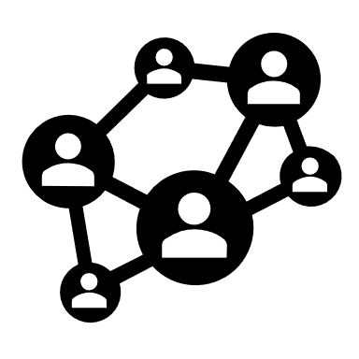
- Logistic regression
- NAÏVE BAYES
- DECISION TREE
- KNN
- RANDOM FOREST
- BAGGING CLASSIFIER
- VOTING CLASSIFIER

Slide 13
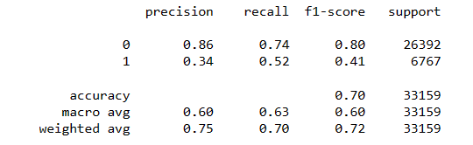
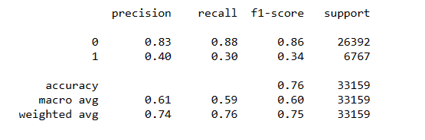
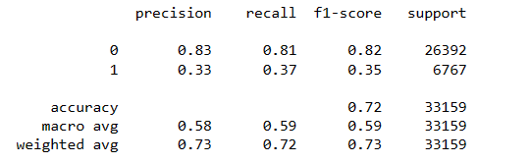
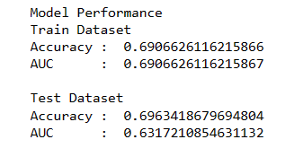
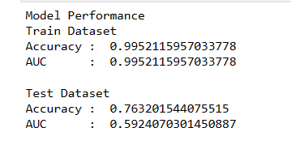
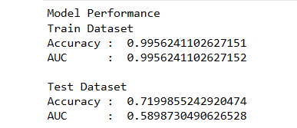
Accuracy score of some of the best models
VOTING CLASSIFIER
BAGGING CLASSIFIER
DECISION TREE

Slide 14
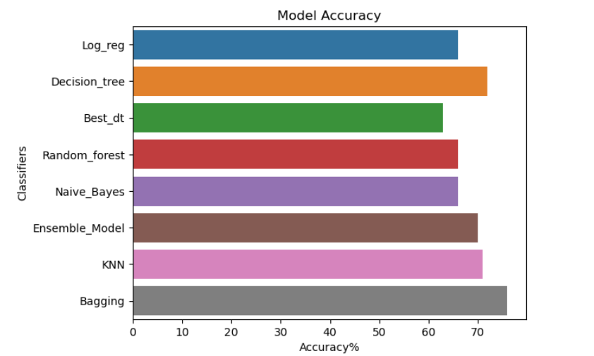
ACCURACY SCORE COMPARISON

Slide 15
Conclusion and future scope
In this project we used some statistical and ML models to predict if a person will show up to medical appointment or not using python on jupyter notebook.
The Dataset we used for this particular project was ‘KaggleV2-May-2016’ from Kaggle.
The best accuracy we got was on bagging classifier which was 76% , but the model was overfitting , the next best model without overfitting we got was on voting classifier which was 70%.This was the best we could do with this dataset.
With better dataset and implementing some Deep learning models we may be able to create a good model for the future.
That would help us predicting the showing up way better than this model.
These model will help the health industry to save their time and give out appointments accordingly.

Slide 16
THANK YOU

